Slide 1
Genetic algorithms

Slide 2
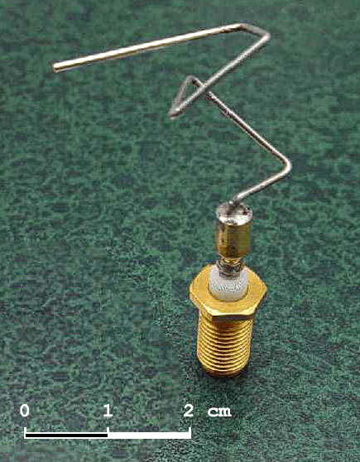
What is a genetic algorithm?
A population based search technique
A subset of evolutionary algorithms
Used in your coursework
They are designed to solve problems in a way similar to sexual selection
https://rednuht.org/genetic_cars_2/

Slide 3
Genetic algorithms
A genetic algorithm is based upon how we evolve as a species to be better adapted to our environment
Each human has approximately 3 billion base pairs of DNA
We breed together to try and make the optimum base pairing for our successive generations

Slide 4
Genetic algorithms
We can apply similar operations to data.
Lets say we have some data which can solve a task with a specific score
We can then rank this data
We can then “breed” the better solutions together to create better children
We can then pseudo randomly mutate them to introduce variance like in nature

Slide 5
What do we need?
We need a task which can prescribe a score to the data
So we can tell how fit the solutions are
We need a suitable data representation
We need this for usability
We need this for speed
You will need this for your coursework ☺

Slide 6
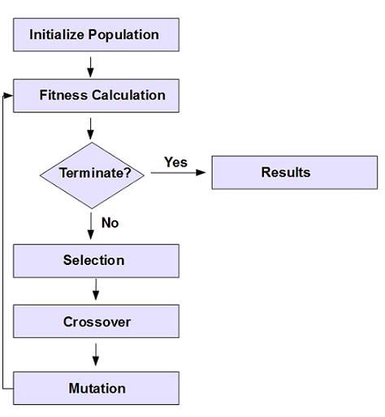
Genetic algorithms
https://www.youtube.com/watch?v=5JOyHDb2OTU

Slide 7
Initialise a population
Data (8) instances | Score
0101011101101010
0000011010101010
1111010010101010
0101011101100010
1101110001111100
0000101011101101
0101011101101010

Slide 8
Evaluation (fitness calculation)
We need to evaluate how well this data solve a specific task
Could be how many “1” the data contains
Could be weights of a neural network
Doesn’t have to be Boolean, could be real numbers
Data (8) instances | Score
0101011101101010 | 77
0000011010101010 | 0
1111010010101010 | 4
0101011101100010 | 10
1101110001111100 | 0
0000101011101101 | 35
0101011101101010 | 17

Slide 9
Selection – Tournament selection
We will make a small tournament of 4 (randomly selected), and then the winners of this tournament will be parents
Tournament entries are randomly selected
Data (8) instances | Score
0101011101101010 | 77
0000011010101010 | 0*
1111010010101010 | 4*
0101011101100010 | 10*
1101110001111100 | 0
0000101011101101 | 35*
0101011101101010 | 17

Slide 10
Selection – Tournament selection
We will make a small tournament of 4, and then the winners of this tournament will be parents
Tournament entries are randomly selected
Data instances | Score
0000011010101010 | 0*
1111010010101010 | 4*
0101011101100010 | 10*
0000101011101101 | 35*

Slide 11
Crossover
We need to crossover the two parents to make another two parents
We do this according to a probability (typically 0.5)
If a random number is less than 0.5 we crossover, if not we copy parents as is. In this instance, the random number is 0.3, so we cross over
Parents | Score
0101011101100010 | 10*
0000101011101101 | 35*
Children | Score
0101011111101101
0000101001100010

Slide 12
Crossover
We can then add these new children to a new population. We repeat this until we have a new population of equal size to the old one
But first…
Parents | Score
0101011101100010 | 10*
0000101011101101 | 35*
Children | Score
0101011111101101
0000101001100010

Slide 13
Mutation
We randomly select bits of the children to mutate
Typically a mutation rate is 0.01 – so if a random number is less than this, we mutate that bit
Parents | Score
0101011101100010 | 10*
0000101011101101 | 35*
Children | Score
0101011111100101
0000101001100010

Slide 14
New population
We repeat selection, crossover and mutation until we have a new population
Once cycle of this is called a generation
We have three main variables within a generic algorithm
Population size
Crossover rate
Mutation rate
We also have type of cross over or mutation.

